Slide 1

Marketing and the Marketing Concept
Chapter 1 Marketing Is All Around Us
Section 1.1 Marketing and the Marketing Concept
Section 1.2 The Importance of Marketing
Section 1.3 Fundamentals of Marketing

Slide 2
Lesson 1.1
Marketing and the Marketing Concept

Slide 3
Marketing and the Marketing Concept
Objectives
Define marketing
Three thins you must follow in marketing
Three Types of Products
List the seven functions of marketing
Understand the marketing concept
Marketing Essentials Chapter 1, Section 1.1

Slide 4
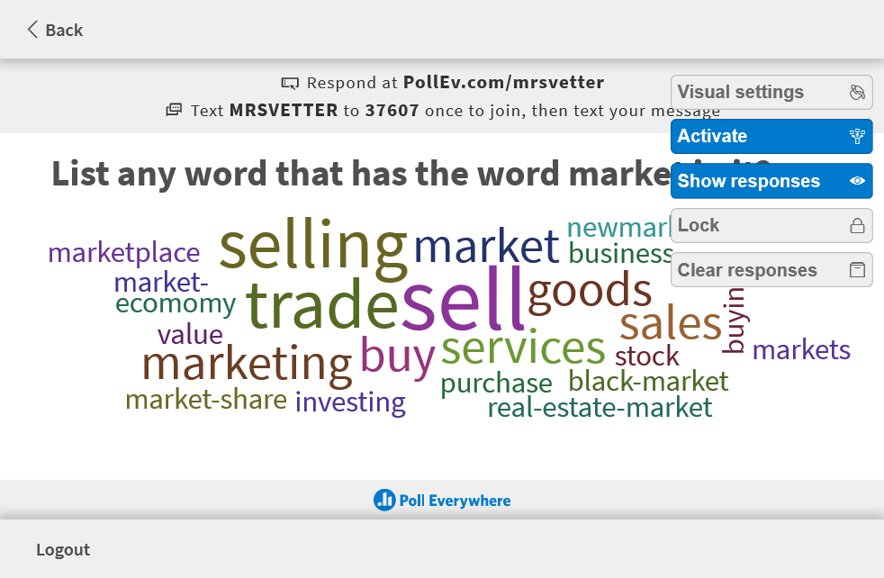

Slide 5
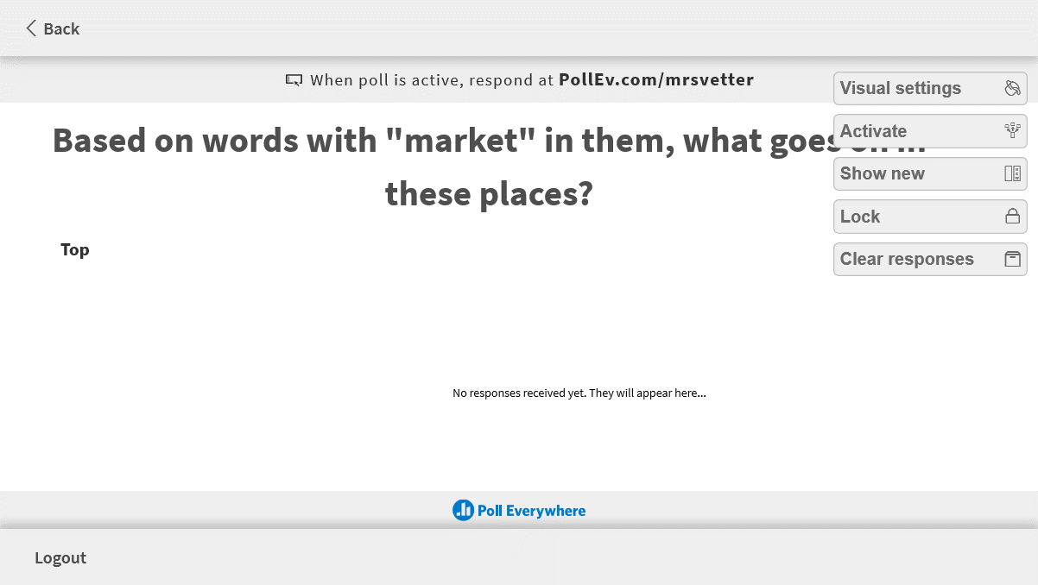
Market

Slide 6
What is a Market
A market is a place where we buy, sell or exchange something (for money or no money)
What goes on:
Buying
Selling
Trading
Exchanging
Bartering

Slide 7

What Is Marketing?

Slide 8
What is Marketing?
Marketing: The management process by which goods and services move from a concept (idea) to the customer. It includes the processes of planning, pricing, promoting, selling, and distributing products that satisfy customers’ needs and wants.
Marketing is everything we do to get the product to the markets!

Slide 9
Marketing is:
Note:
Is NOT just about advertising – so much more
Includes many different functions
Is always about and directed towards the customer
Marketing is a process = ongoing and changes always

Slide 10
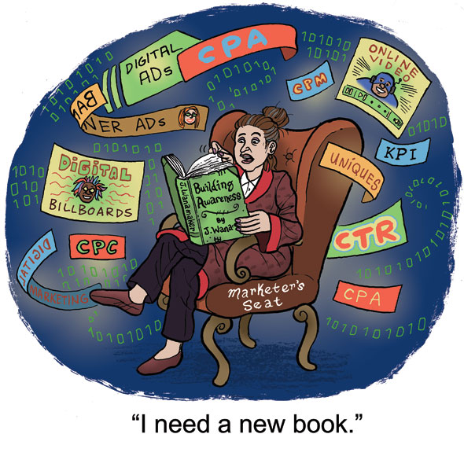
Marketers MUST Keep up with:
Trends
start selling what is the hot new items that people want
What is hot in the food industry?
What is hot in the car industry?
What is happening as a result of Covid?
Consumer Attitudes
Support what people believe in
Nike & Colin Kapernik
The NFL & Social injustice
Customer Relationships
implement something that gets customers to come back and buy again or get their friends to
Loyalty Programs are huge
Service
Quality
Easy access
Marketing Essentials Chapter 1, Section 1.1

Slide 11
75% are likely to start shopping at a company that supports an issue they agree with
Fewer people (44%) say price is among the most important attributes of a company compared to environmentally-friendly business practices (71%), social responsibility (68%), and giving back to the local community (68%).
71% of people think it’s important for businesses to take a stance on social movements.
59% are likely to stop shopping at a company that supports an issue they disagree with.
70% of Generation Xers (ages 35-54) and 54% of millennials (ages 18-34) are likely to stop shopping at a company that supports an issue they disagree with compared to 37% of baby boomers (ages 55+).

Slide 12
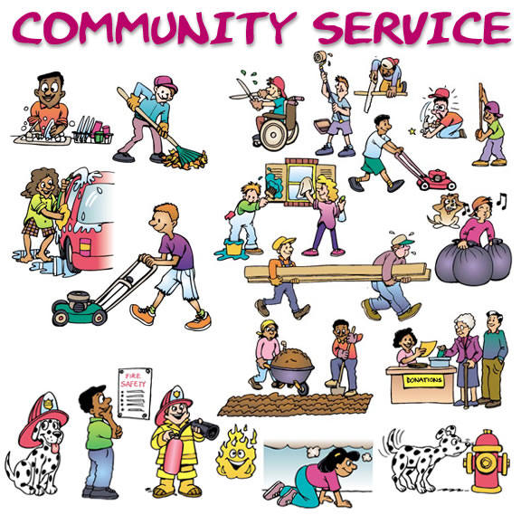
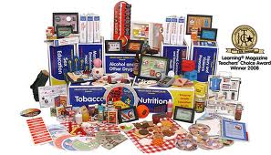
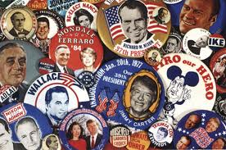
Three types of Products
Marketers sell products that people want and need
Three types of products can be marketed
Goods
Services
Ideas

Slide 13
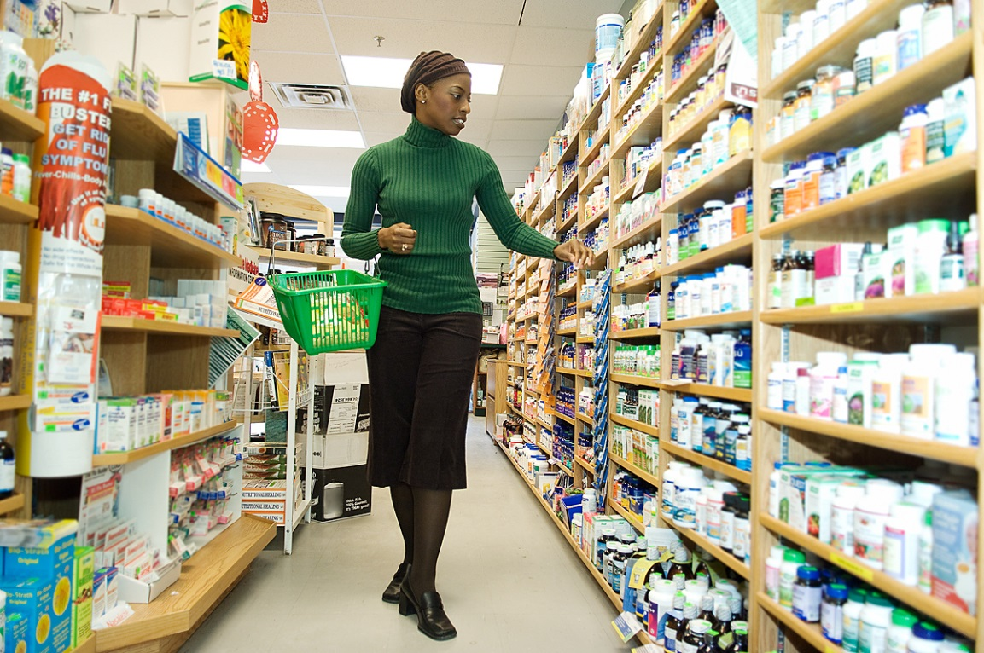
1. Goods : tangible items of monetary value (we can sell, buy, or trade) that satisfy customer needs and wants:
List 3 examples of goods in your notes:
Examples of marketed goods X include:
Home furnishings
Cars
Electronics
Food

Slide 14
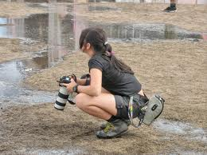
2. Services: Intangible (can’t touch) items of monetary value (pay someone to do it for you) that satisfy customer needs & wants
List 3 examples of services in your notes:
Examples of services X that may be marketed are:
Automotive repair
Hair styling
Legal aid
Financial consulting
Education
Entertainment

Slide 15
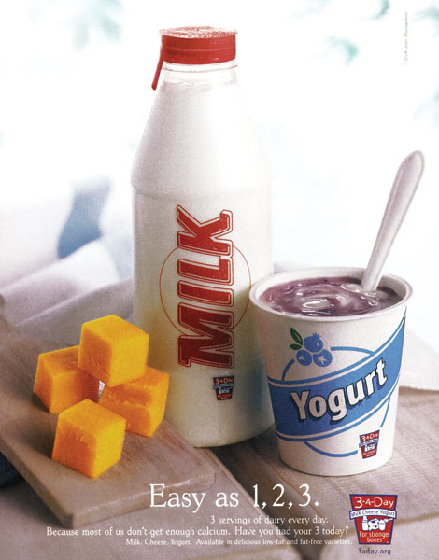
What does this ad make you think?
What is being sold?
- No brand, no specific product
- Not selling an economic good/service
This ad promotes the idea of a healthy diet that includes dairy products

Slide 16
Ideas: an opinion, view, or belief
- can’t be sold, but will try to get you to believe it through marketing
List three types of ideas in your notes:
Examples of ideas that might be marketed are:
A candidate’s political platform
A public service initiative, such as don’t text and drive, don’t smoke or stay in school

Slide 17


Slide 18
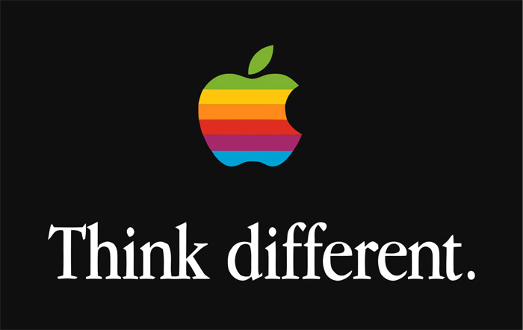
Is this a Good, Service, or Idea?

Slide 19
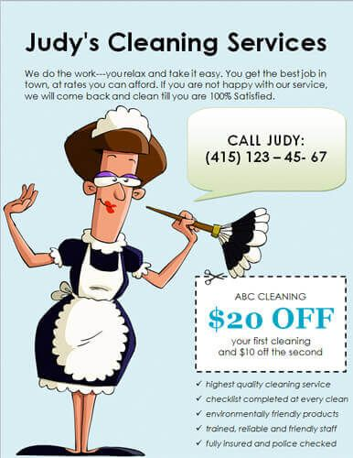
Is this a good, Service, or Idea?

Slide 20

Is this a good, Service, or Idea?

Slide 21


Slide 22



Slide 23
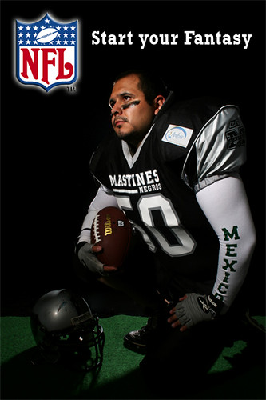

Slide 24


Complete the Classmarker Worksheet: Is it a Good, Service or Idea questions. This is not a test, you can use your notes.

